Slide 1
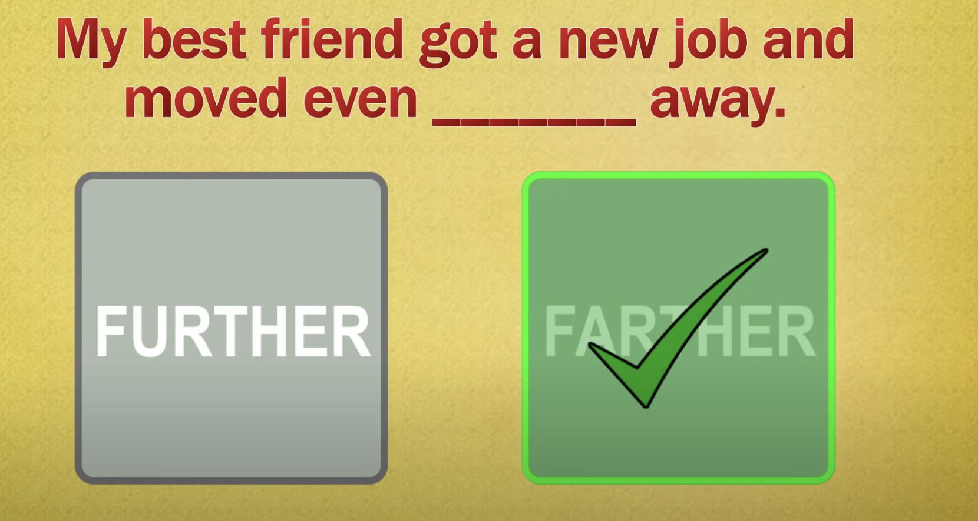
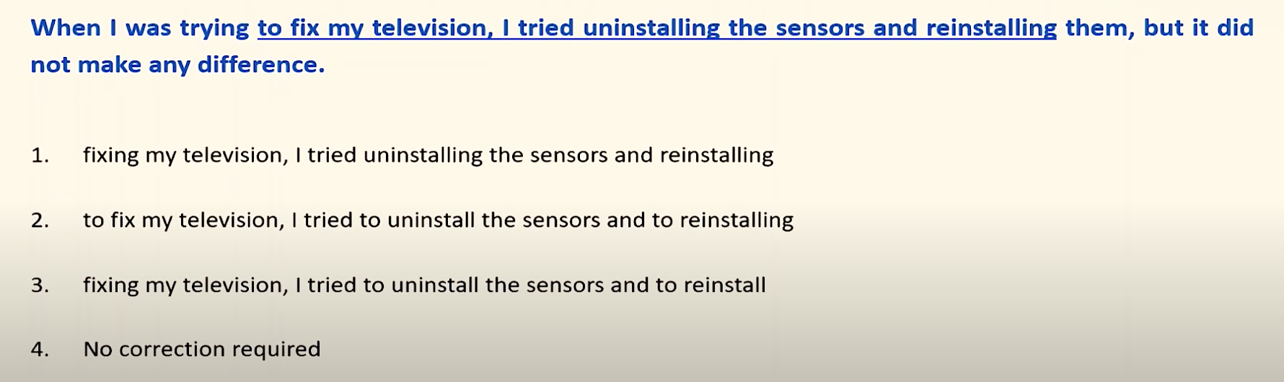
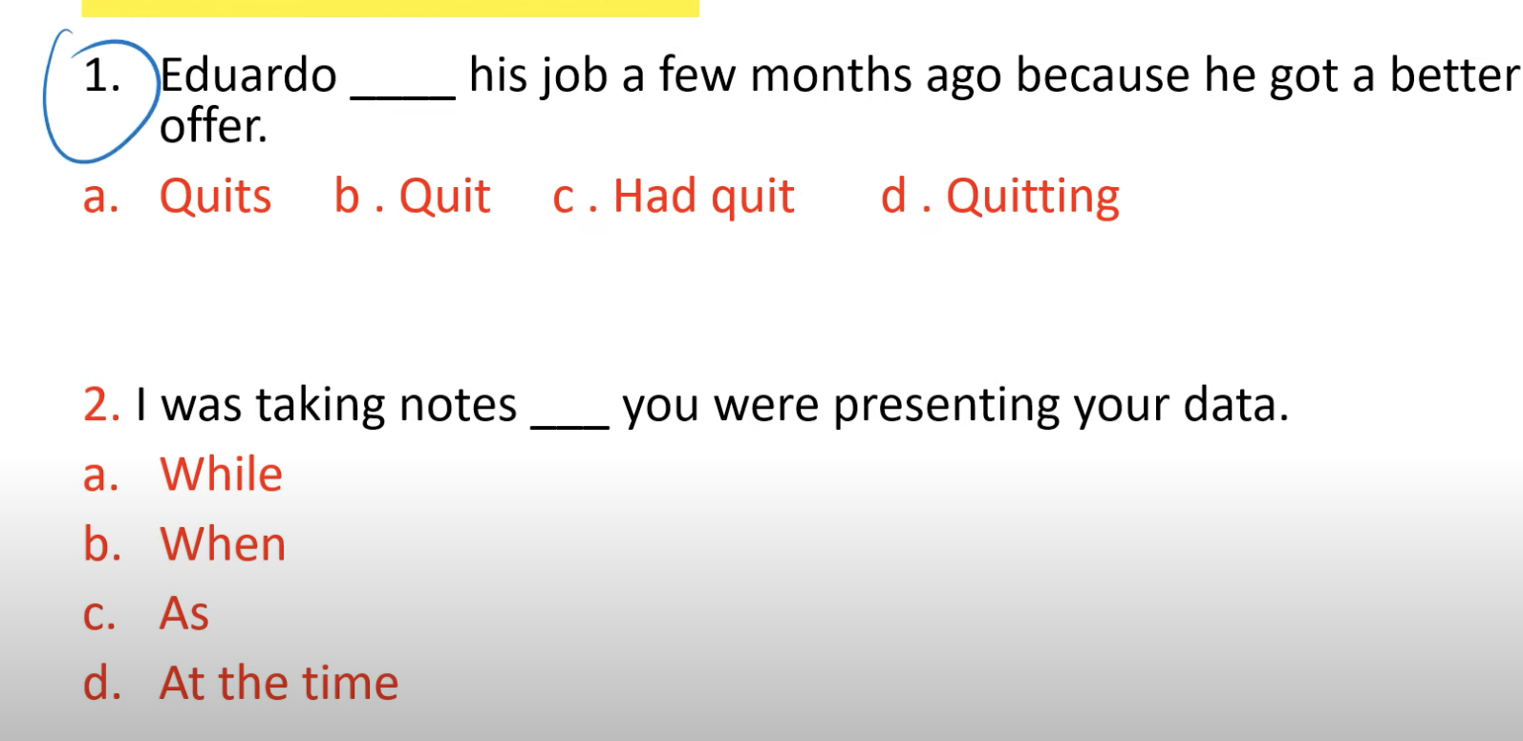
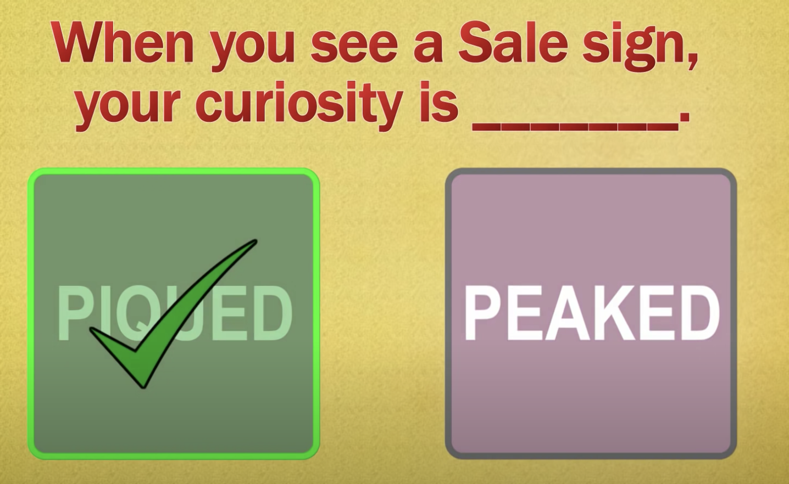
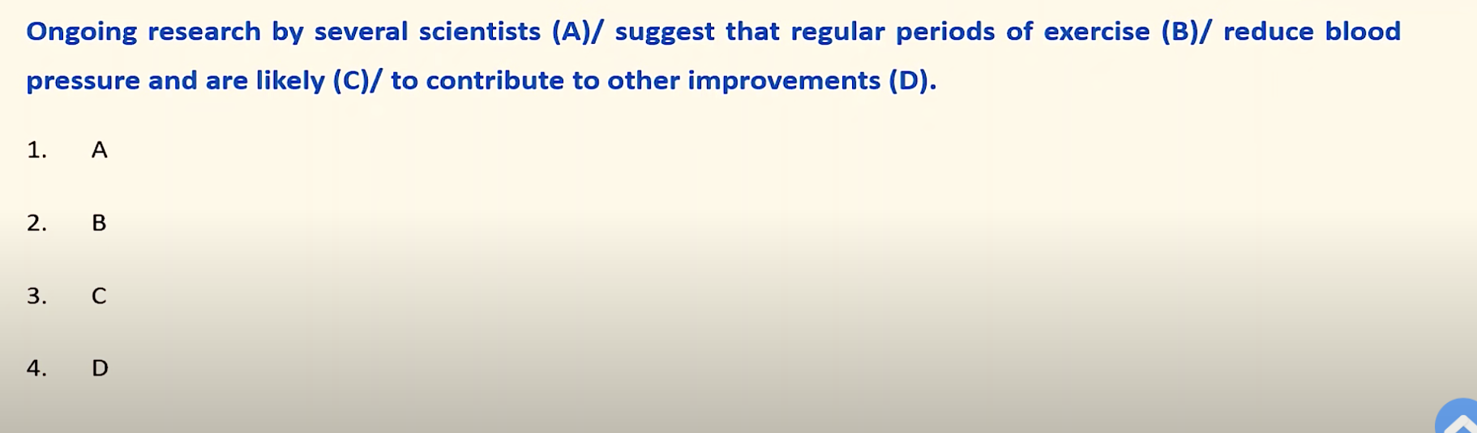
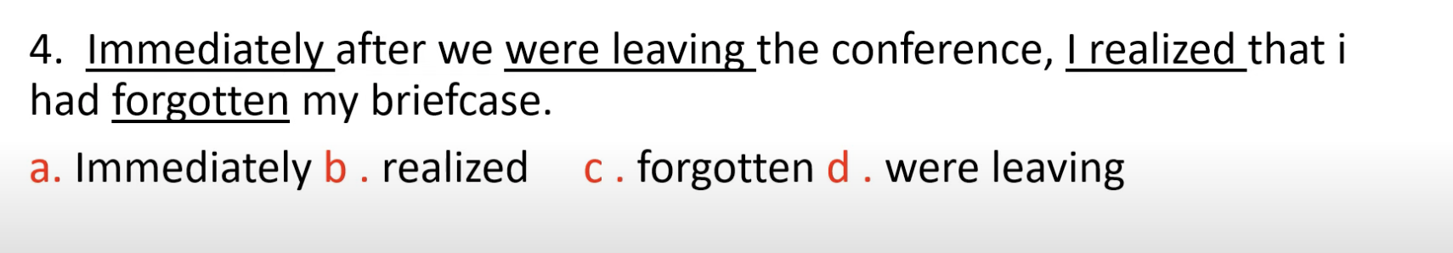
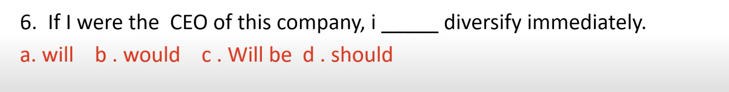
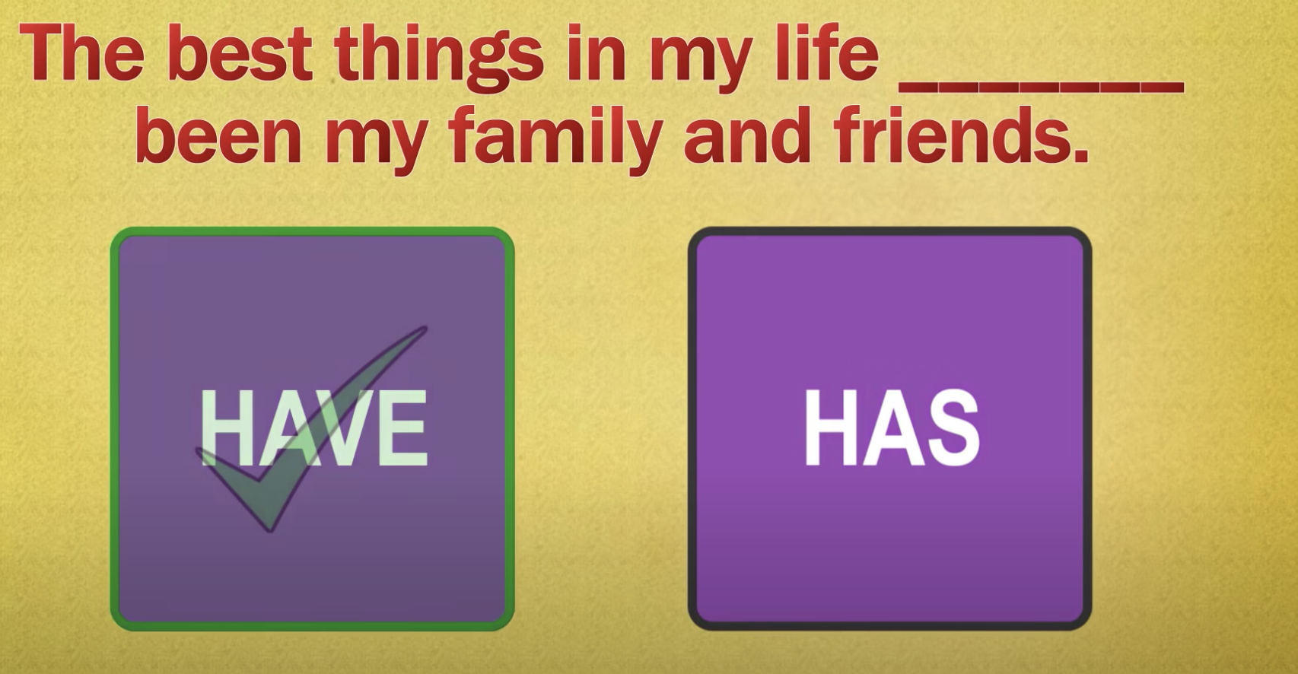
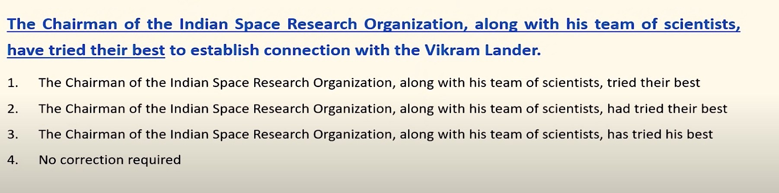
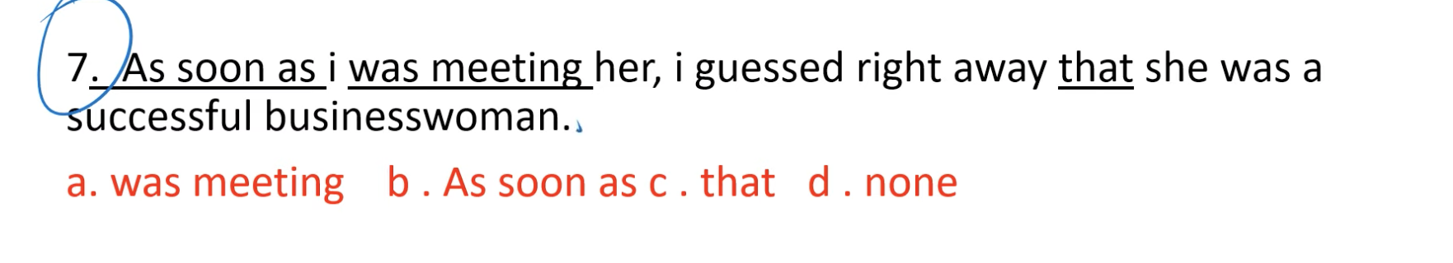
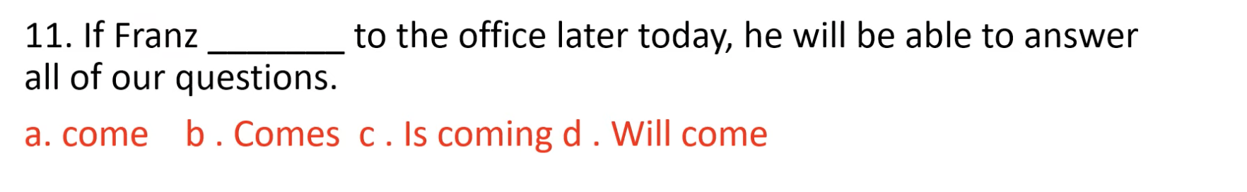
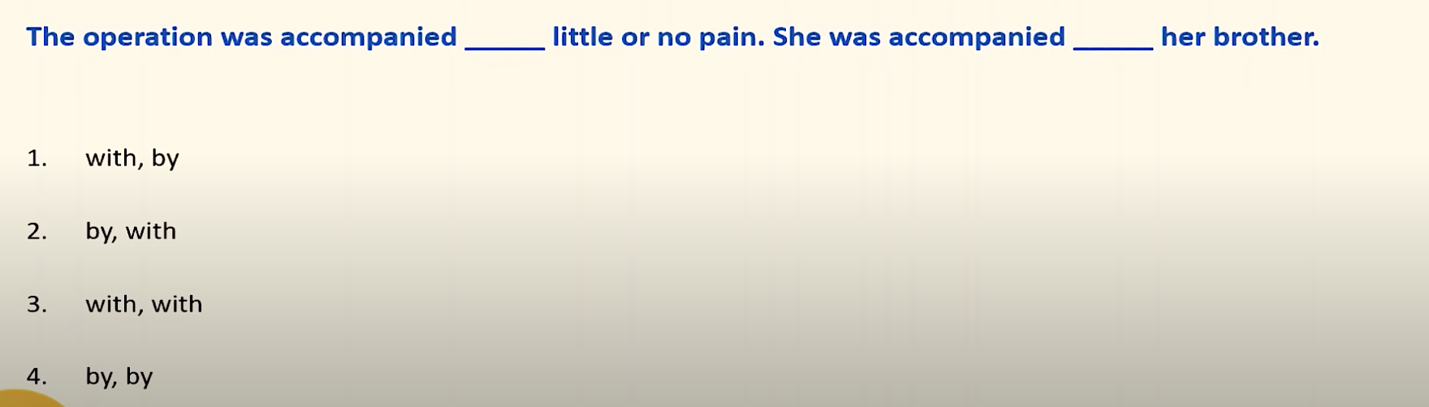
Ans - 1. Quit , because the sentence is simple past tense.2. while . 4. rule is that if sentence has AFTER then after that there should be simple past and not continues past . 6. after WERE there should be WOULD 7. after AS SOON AS and AFTER there should always be simple past tense and not past continues 11. COMES is right , it’s a grammer rule like “if you work hard , you will pass”.
1. Trying fixing , is not a correct word … so remove 1 1nd 3 , but in option 2 , its state uninstall and reinstalling .. Which is a parallelism mistake , it can be uninstall and reinstall , so 3 is also not right , ans is option 4 … 2nd – the sentence is present tense , so instead of SUGGEST it should be SUGGESTS , that’s why the ans is B … 3rd ans is 3 .. It should be has tried … 4th – “accompanies by” is typically used with people and “accompanied with” with object / things

Slide 2
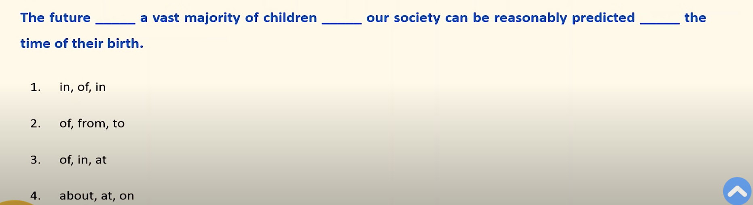
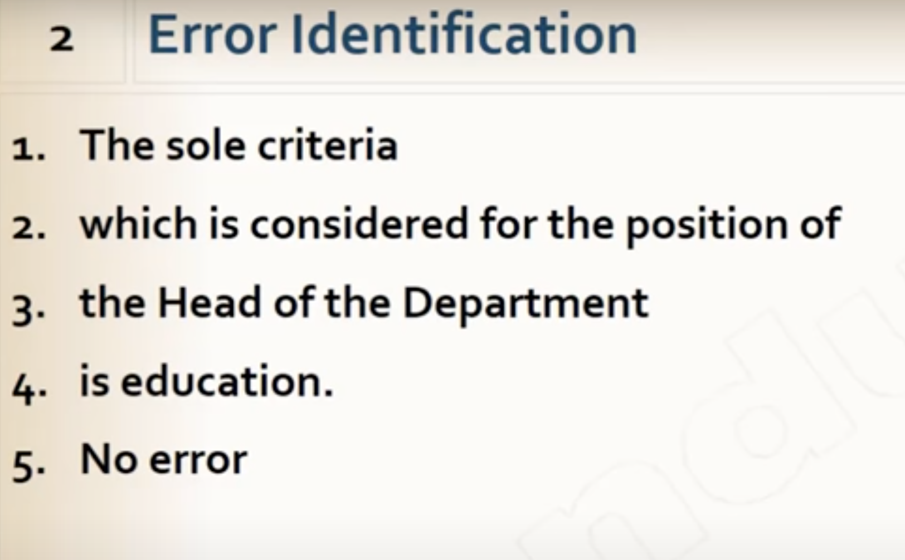
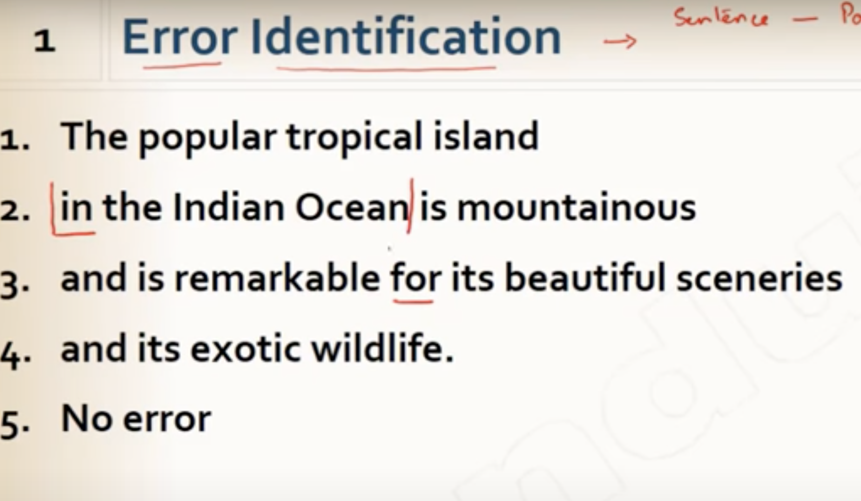
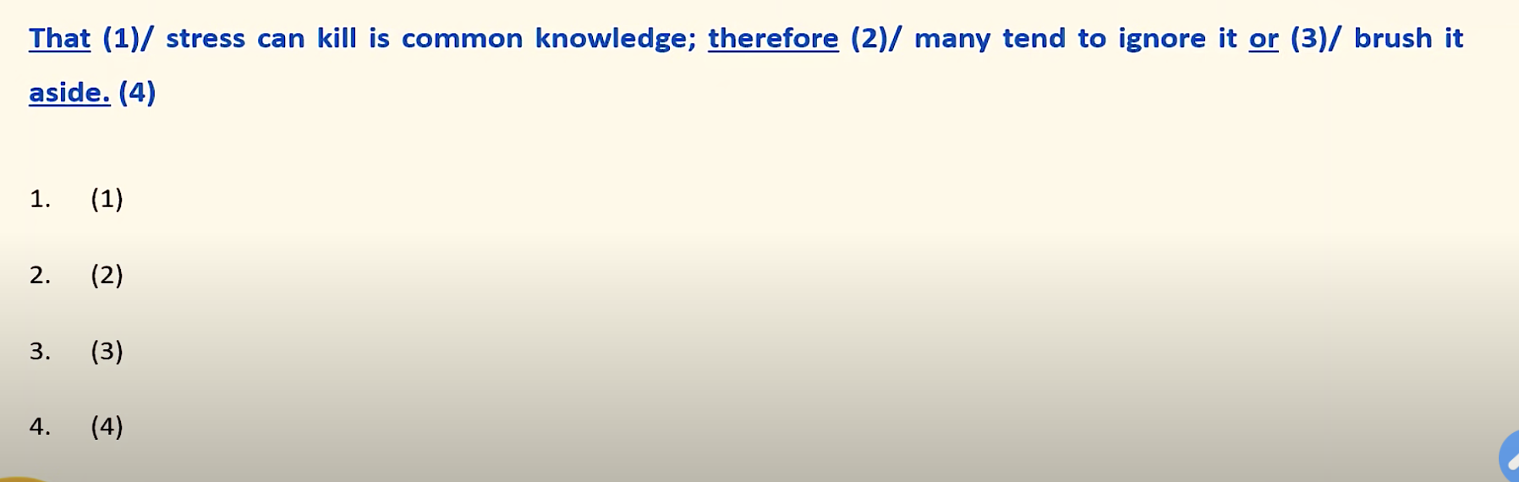
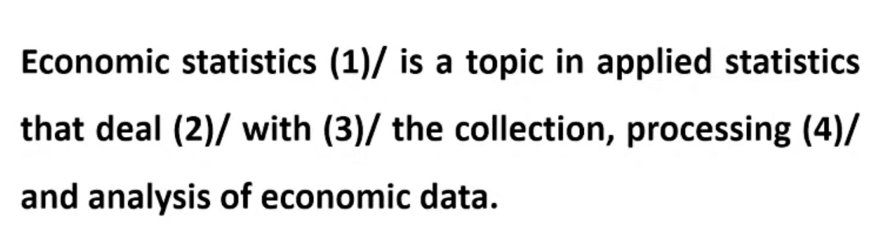
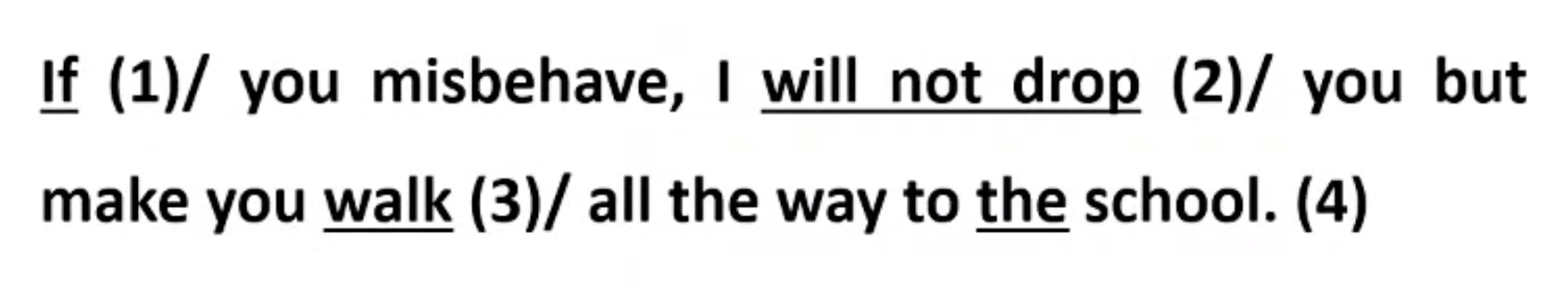
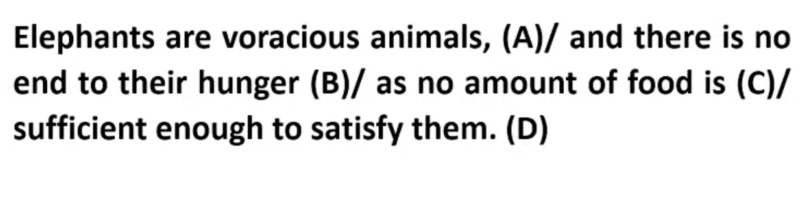
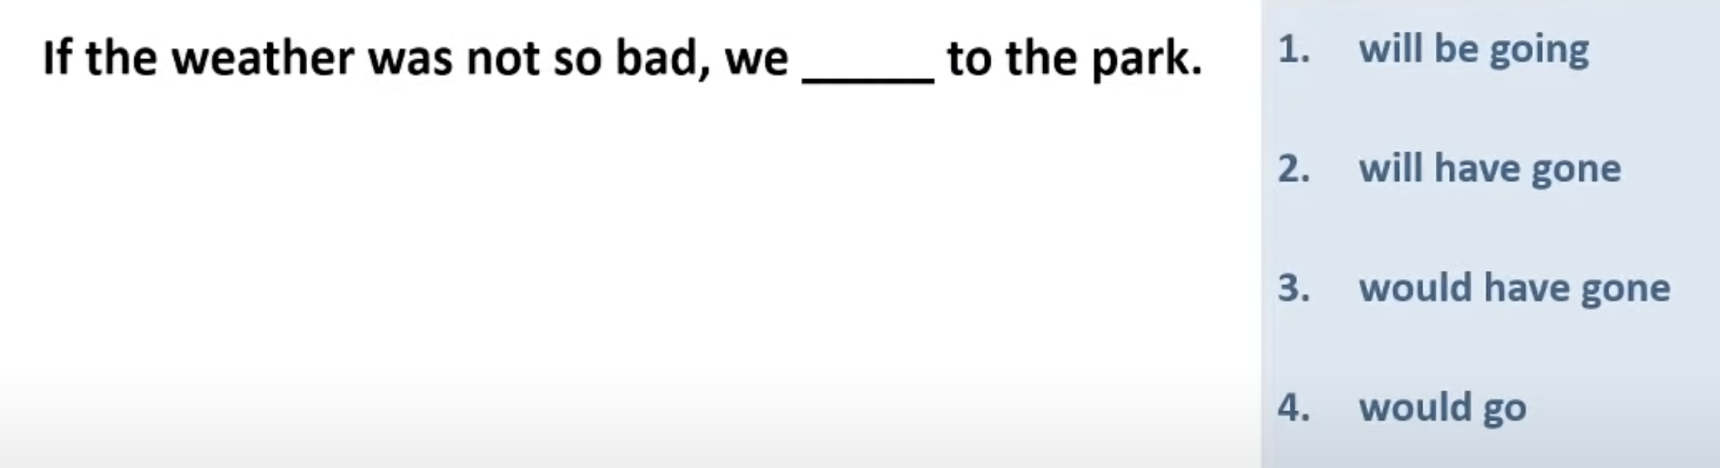
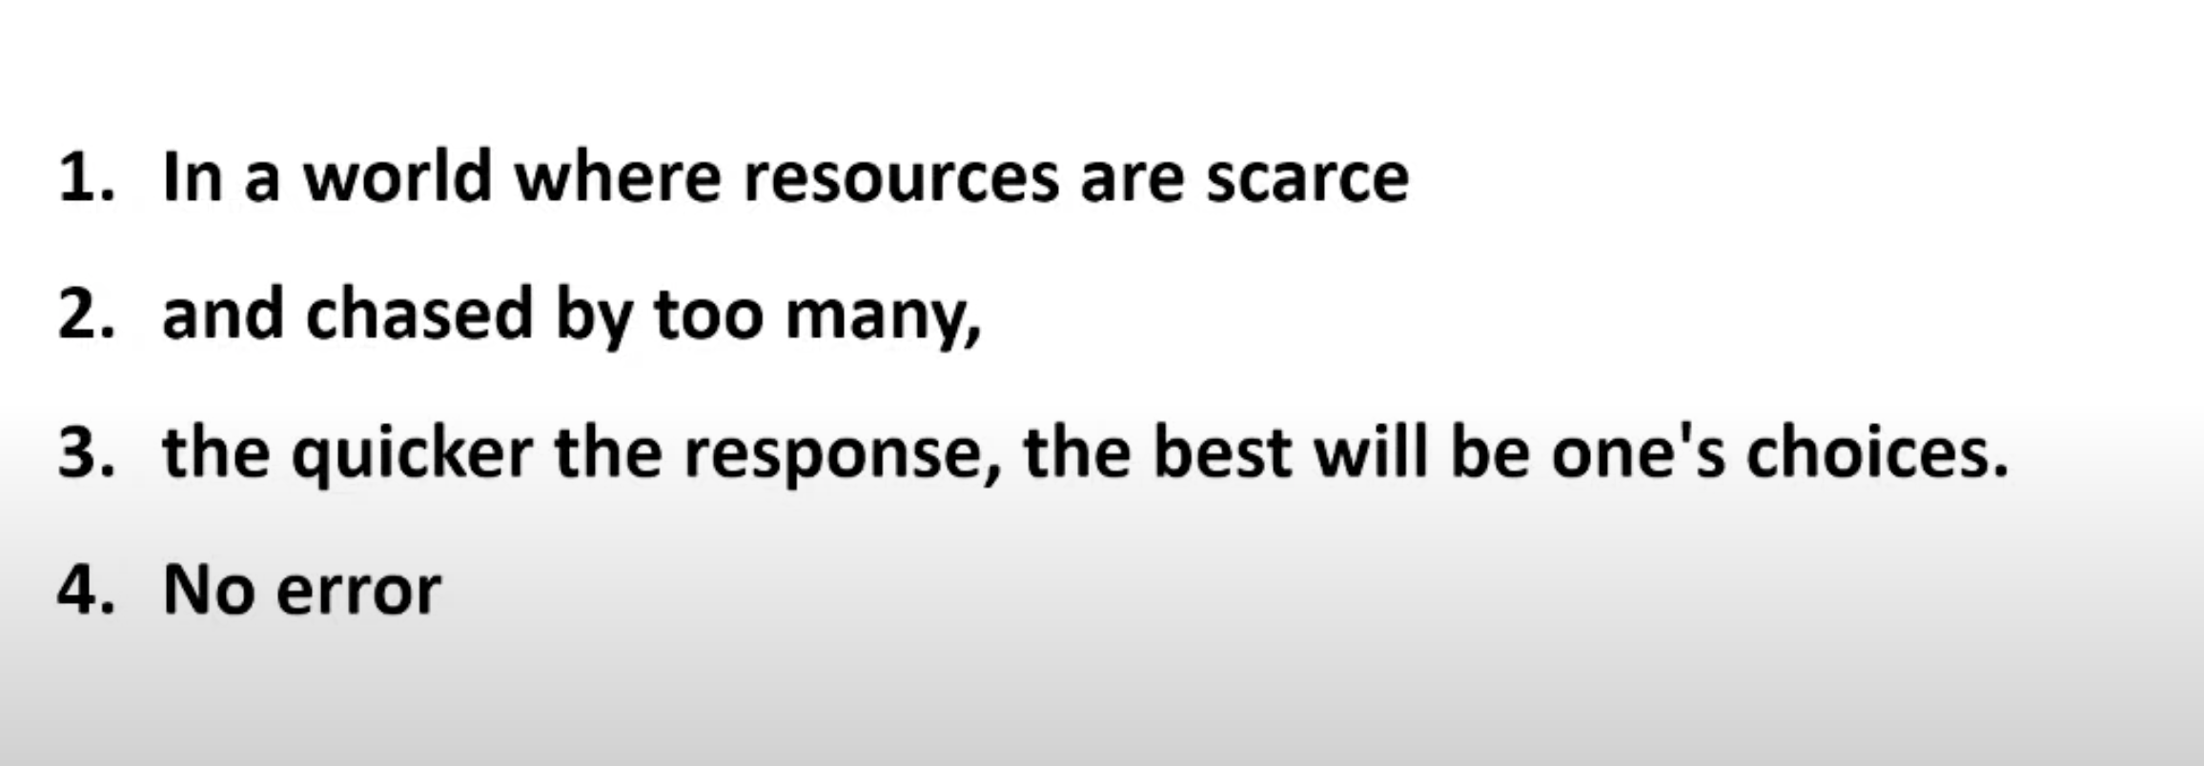
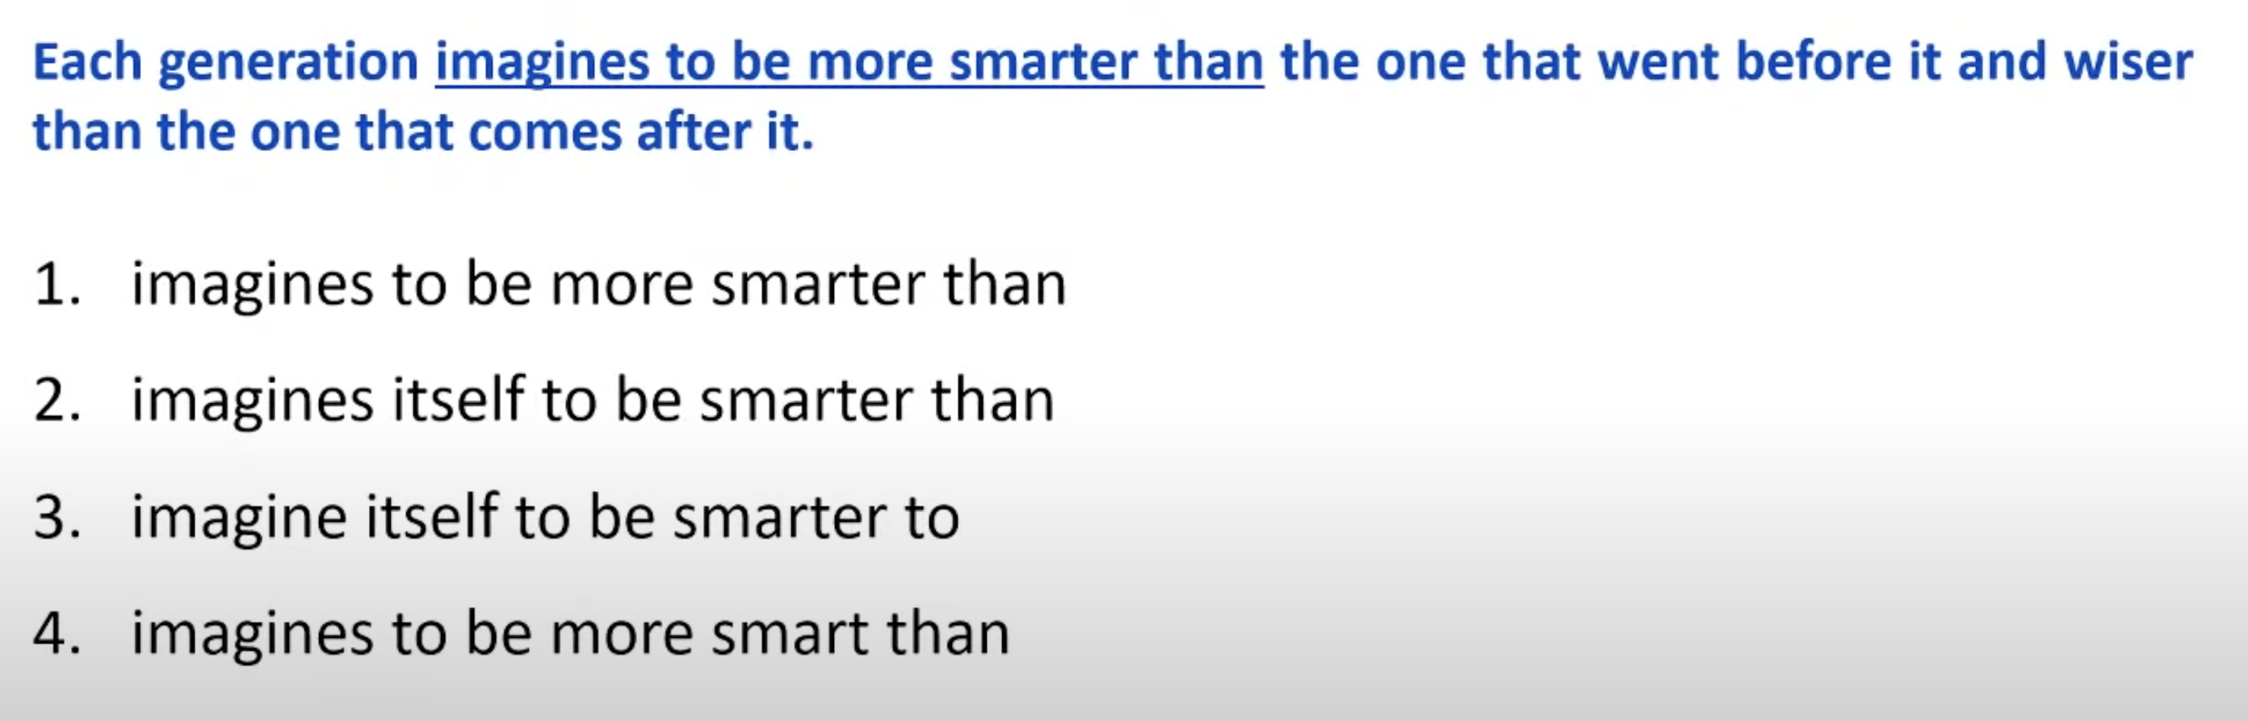
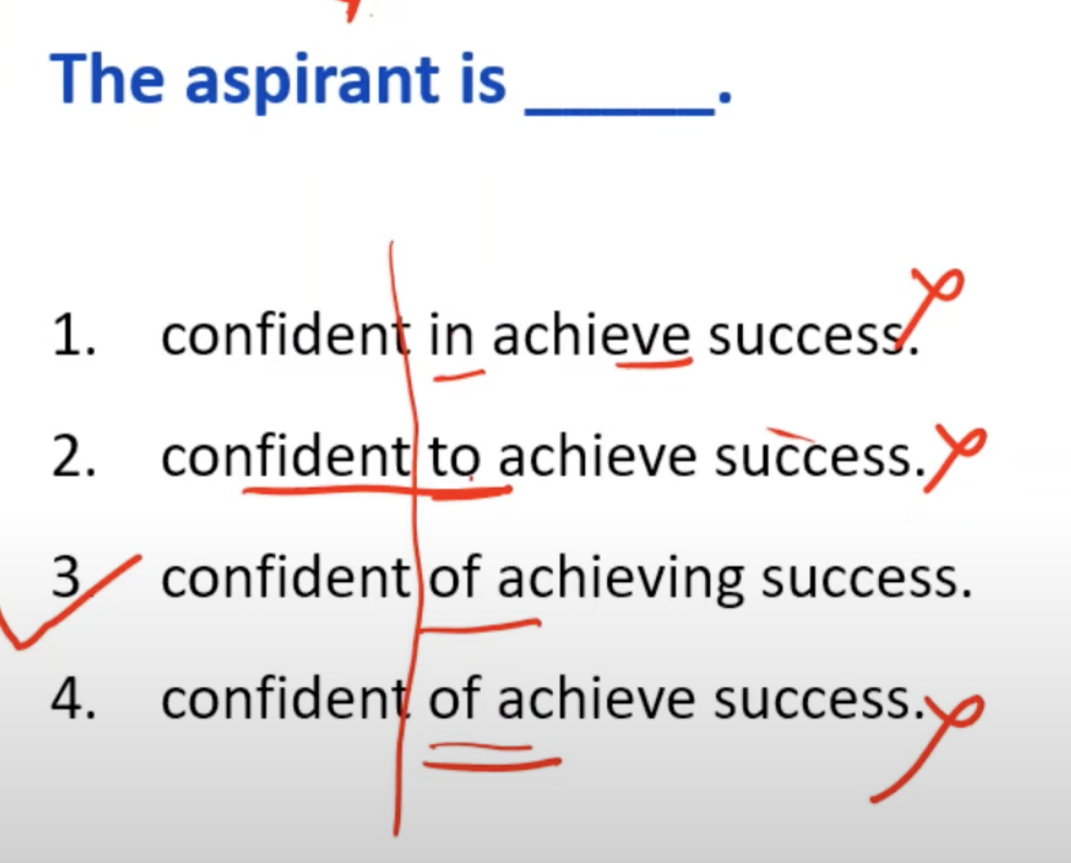
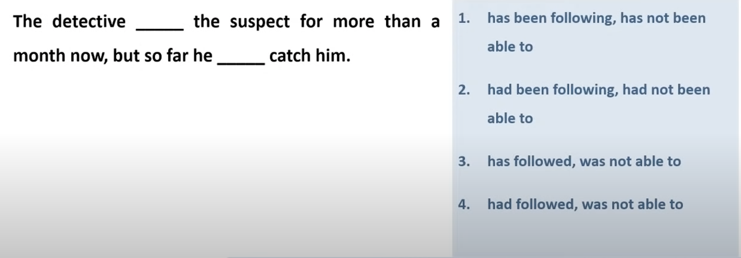
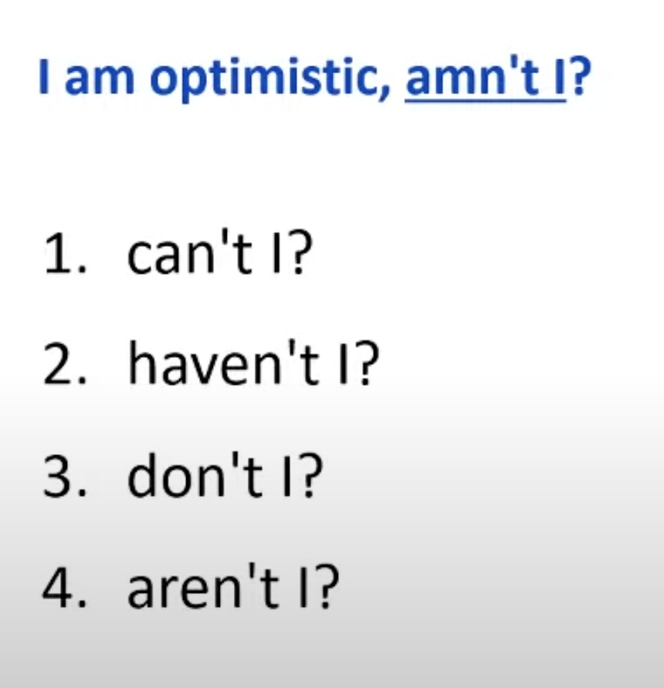
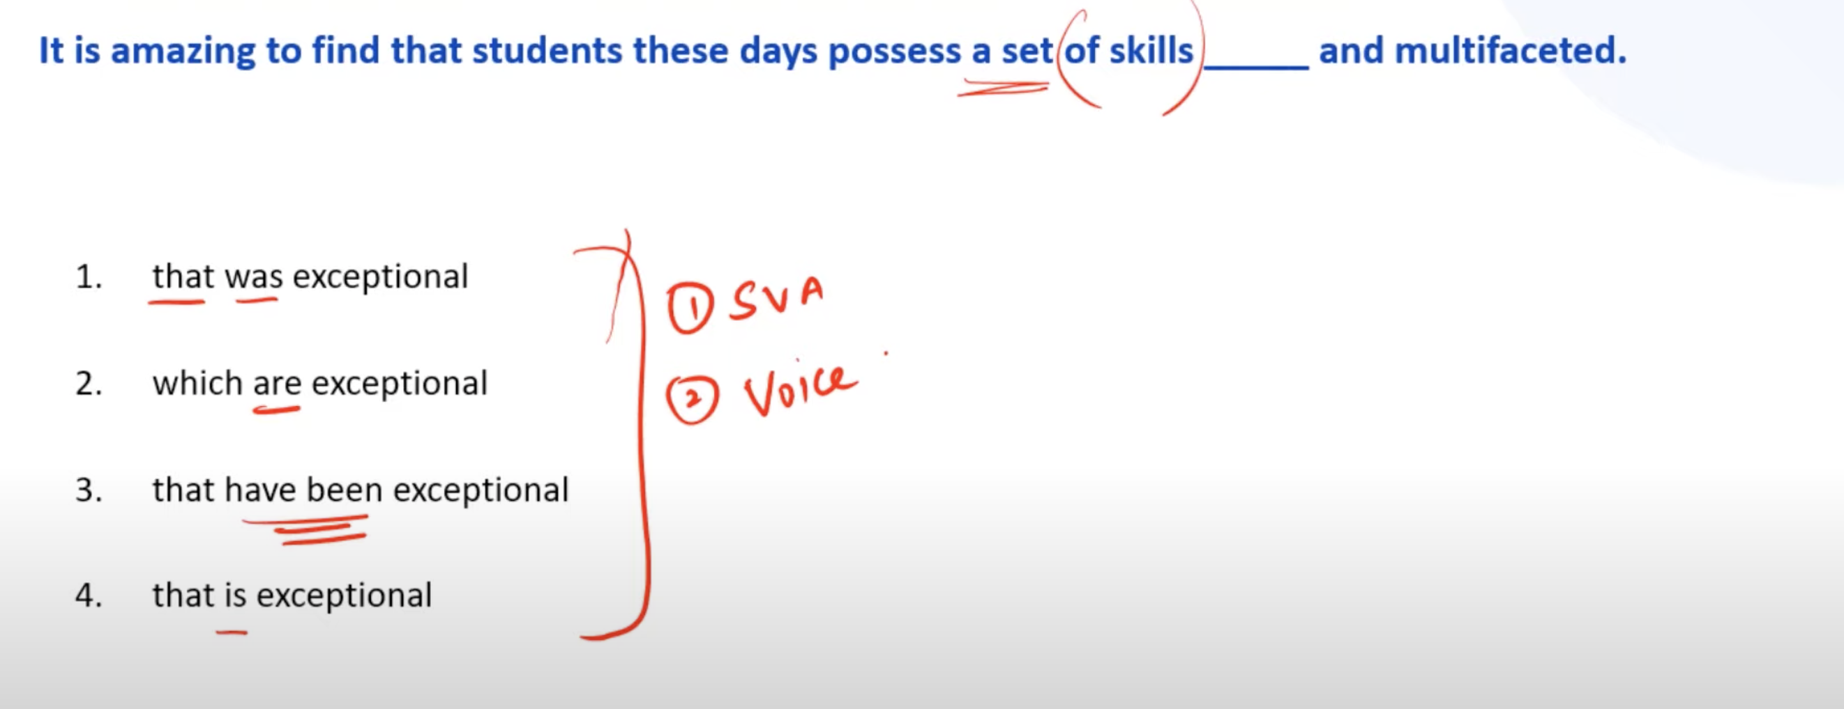
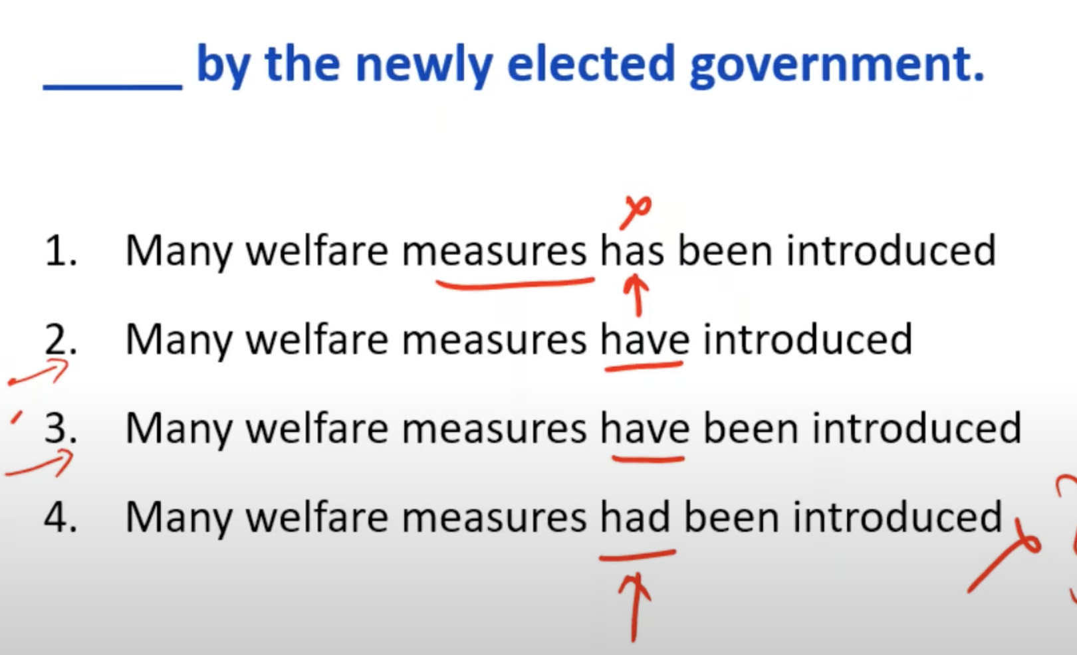
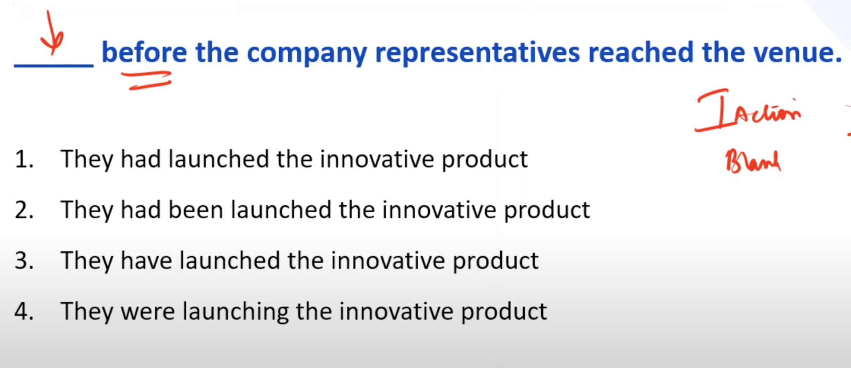
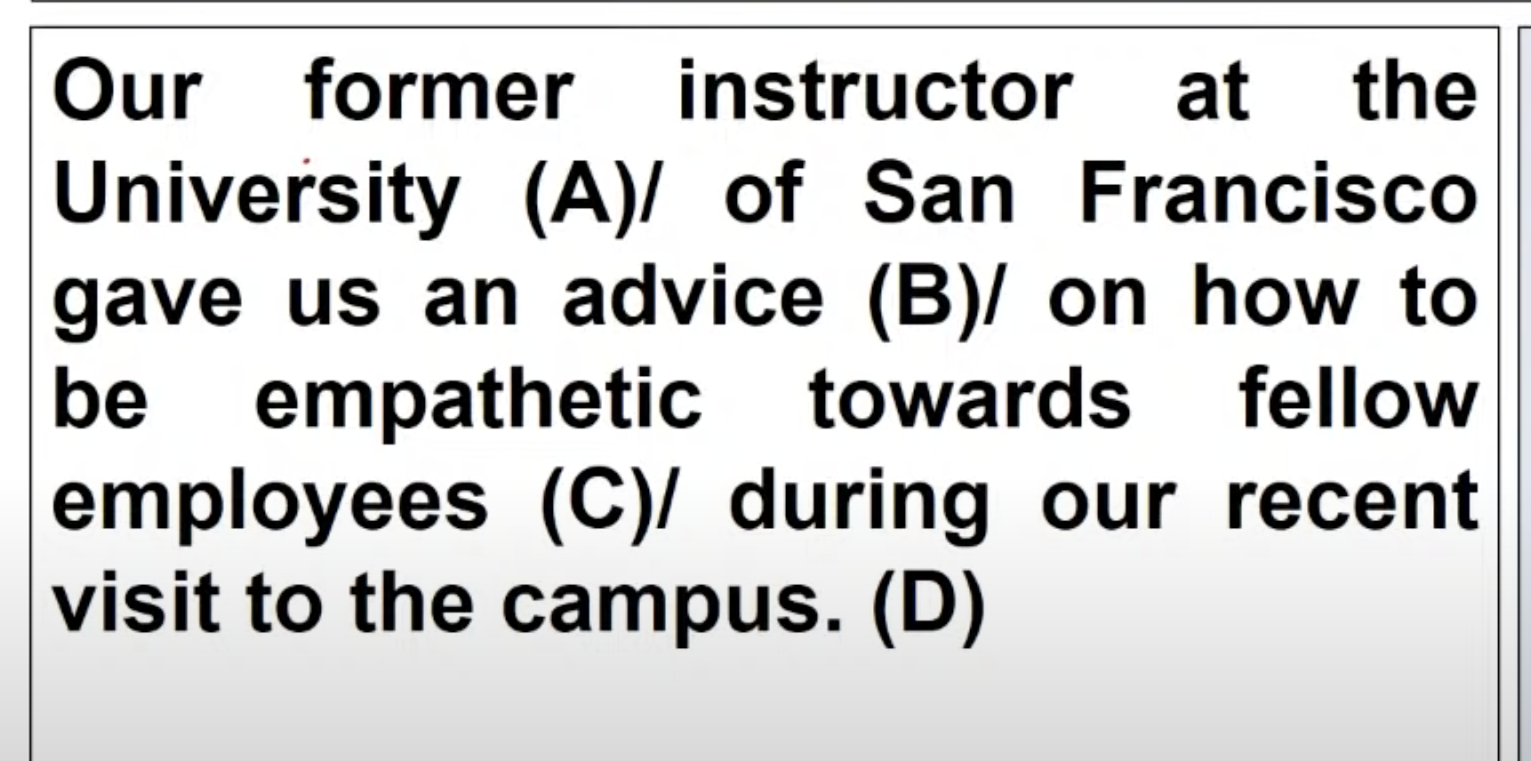
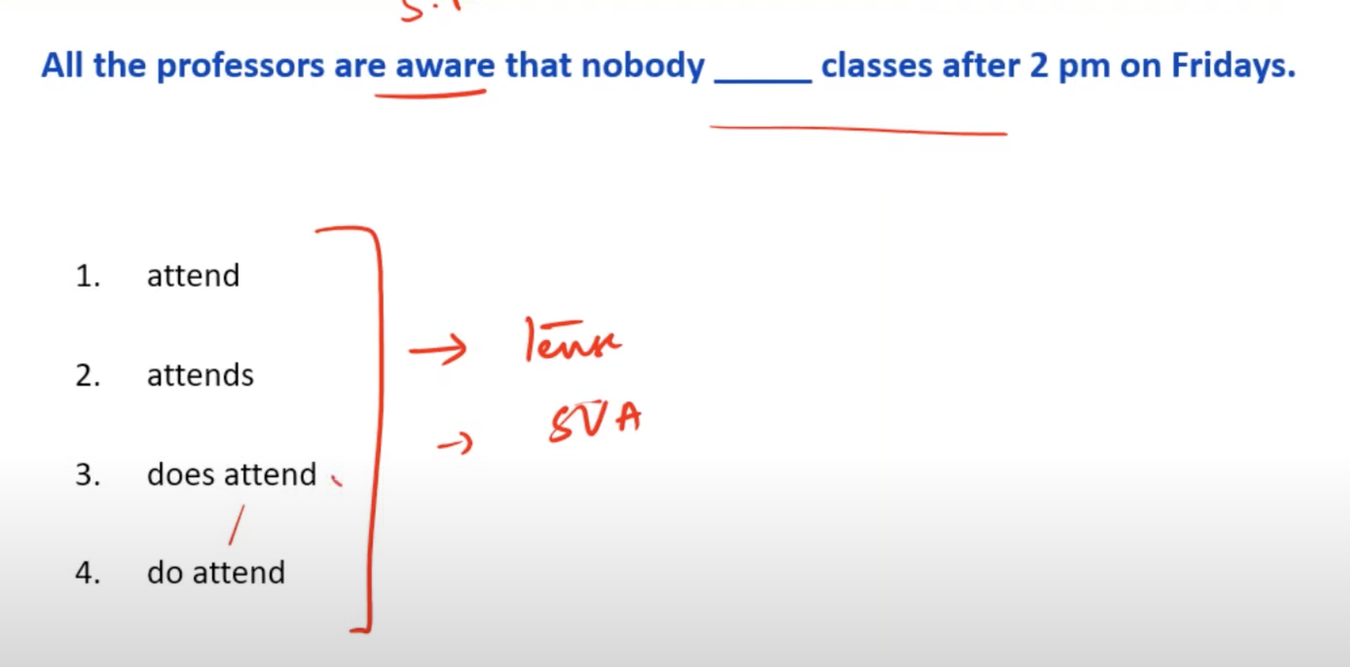
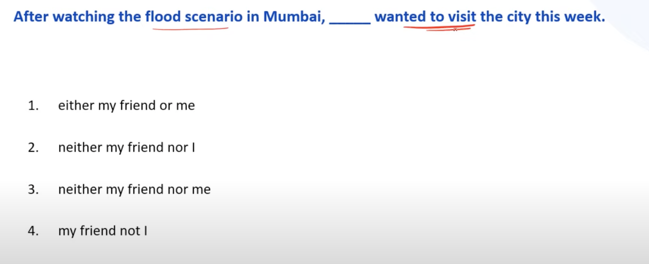
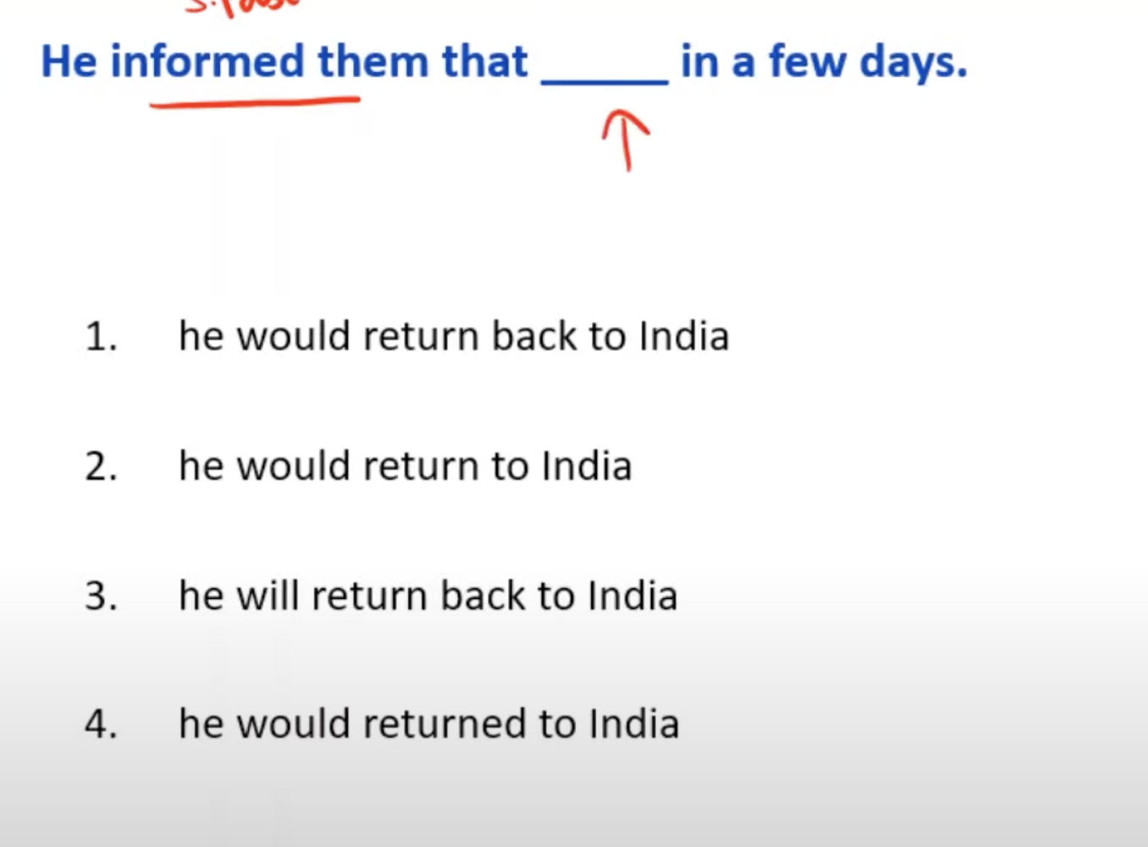
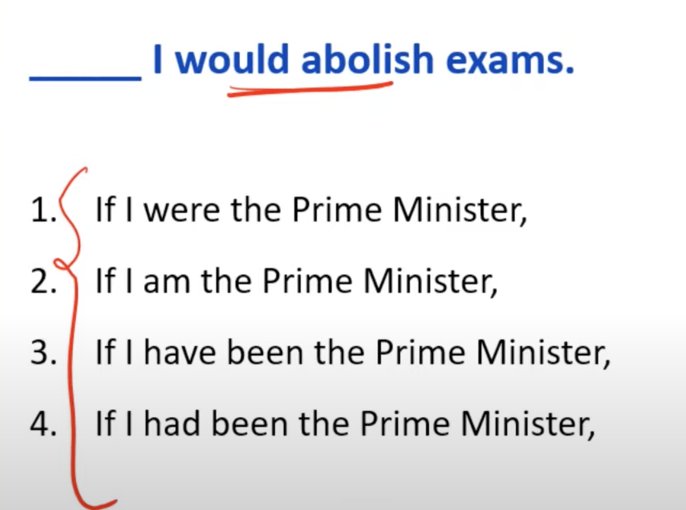
https://www.youtube.com/watch?v=U_FJzb0dJa4&list=WL&index=3
https://www.youtube.com/watch?v=y0g5wGIBilU&list=WL&index=4
https://www.youtube.com/watch?v=LVXBESeiajc&list=WL&index=2
1st --- with predicted its always “at” so 3 is the right answer .. 2nd – the connector between 2 sentences are wrong , because first sentence is a +ve knowledge and second is opposite to it , so instead of “therefore ”, it should be connected with “but”

